Slide 1

Data and metadata exchange in WMO
Enrico Fucile
Chief Data Representation, Metadata and Monitoring Division

Slide 2

WMO No. 306 Manual on Codes
Volume I.1 ( Obsolete, frozen )
Alphanumeric Codes (metar, synop, temp …)
Volume I.2 ( Easy to maintain )
BUFR, GRIB
Table Driven Code Forms
Volume I.3 (Sustainability problems )
XML model driven, ISO, OGC

Slide 3
WMO CF-netCDF workshop 19-20 September 2019
CF panel and WMO representatives of programmes and Data and Metadata Expert Teams agree that a WMO Expert Team on CF Conventions can benefit both CF community and WMO.

Slide 4
WMO Expert Team on CF Convetions
To consider specific requirements by WMO Programmes for the implementation of CF-netCDF data profiles and extensions, and evaluate the particular choice of data format in consultation with other expert teams [ET-TDCF] [ET-XML].
To ensure that new proposals are harmonized with existing WMO CF data profiles and extension and coordinate with other Programmes in their further development.
To collaborate with [ET-TDCF] on parallel implementation or mapping using BUFR or GRIB of the WMO CF data profile and extension developed by the team.
To collaborate with the CF community through CF processes to participate in the enhancement of the CF conventions and enlargement of CF controlled vocabularies to meet the need of WMO Programmes and avoid nonconformance to CF conventions or CF data model, by evaluating all candidate CF extensions as possible CF enhancements before accepting them as WMO CF extensions.
To avoid the need to create forks of the CF convetions by collaborating with the CF community and considering alternative options.
To provide a technical reference implementation of data validation tools for profiles and extensions proposed.

Slide 5
WMO No. 306 Manual on Codes
Volume I.1 ( Obsolete, frozen )
Alphanumeric Codes (metar, synop, temp …)
Volume I.2 ( Easy to maintain )
BUFR, GRIB
Table Driven Code Forms
Volume I.3 (Sustainability problems )
XML model driven, ISO, OGC
Volume I.4 (to be drafted)
CF-NetCDF

Slide 6
Amendment of Manuals Simple procedure (fast-track)
Expert Team
SC-IMT Chair
National Focal Points
Draft proposal
Approve and
Submit proposal for comments
Agree
President of INFCOM
Requirement
Approve
Adopts
amendments
President of WMO

Slide 7
How to publish new BUFR elements and sequences
Step 1: Proposal submitted to WMO Inter-Programme Expert Team on Codes and Maintenance (IPET-CM)
Step 2: Proposals reviewed and either accepted for validation or revised and resubmitted
Step 3: Template validated and result of validation reported to IPET-CM
Step 4: Following successful validation, WMO focal points (national, JCOMM etc) notified of changes for comment
Step 5: If no objections changes implemented in subsequent update (~ 6 monthly)

Slide 8

Validation of the proposal
Encoding / decoding of test data using proposed elements / sequences by two different centres, using different software
Tests whether templates / elements suitable for observations to be encoded
Flags whether any problems likely with encoding / decoding the data

Slide 9
Case study: JCOMM
JCOMM nominated Mr. David Berry (NOC) as coordinator to be part of the IPET-CM to
Propose new BUFR element and sequences
Validate and refine the proposal with the help of IPET-CM members

Slide 10
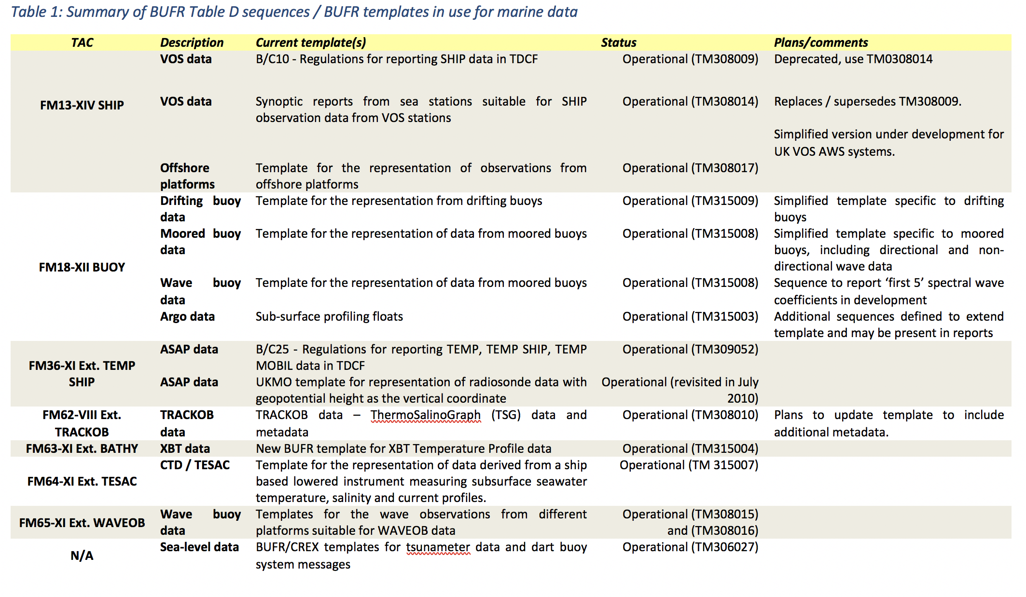
BUFR Sequences approved and operational

Slide 11
Example – first 5 Fourier coefficients for wave data (original proposal)
Table Reference | Element name | BUFR
 |  | Unit | Scale | Reference value | Data width (bits)
F XX YYY
0 42 011 | a1 coefficient of the directional Fourier series | Numeric | 4 | -2 | 15
0 42 012 | b1 coefficient of the directional Fourier series | Numeric | 4 | -2 | 15
0 42 013 | a2 coefficient of the directional Fourier series | Numeric | 4 | -2 | 15
0 42 014 | b2 coefficient of the directional Fourier series | Numeric | 4 | -2 | 15
0 42 015 | Check factor K | Numeric | 2 | 0 | 12

Slide 12
Example – first 5 Fourier coefficients for wave data (original proposal)
Table Reference | Element name | BUFR
 |  | Unit | Scale | Reference value | Data width (bits)
F XX YYY
0 42 011 | a1 coefficient of the directional Fourier series | Numeric | 4 | -20000 | 15
0 42 012 | b1 coefficient of the directional Fourier series | Numeric | 4 | -20000 | 15
0 42 013 | a2 coefficient of the directional Fourier series | Numeric | 4 | -20000 | 15
0 42 014 | b2 coefficient of the directional Fourier series | Numeric | 4 | -20000 | 15
0 42 015 | Check factor K | Numeric | 2 | 0 | 12

Slide 13
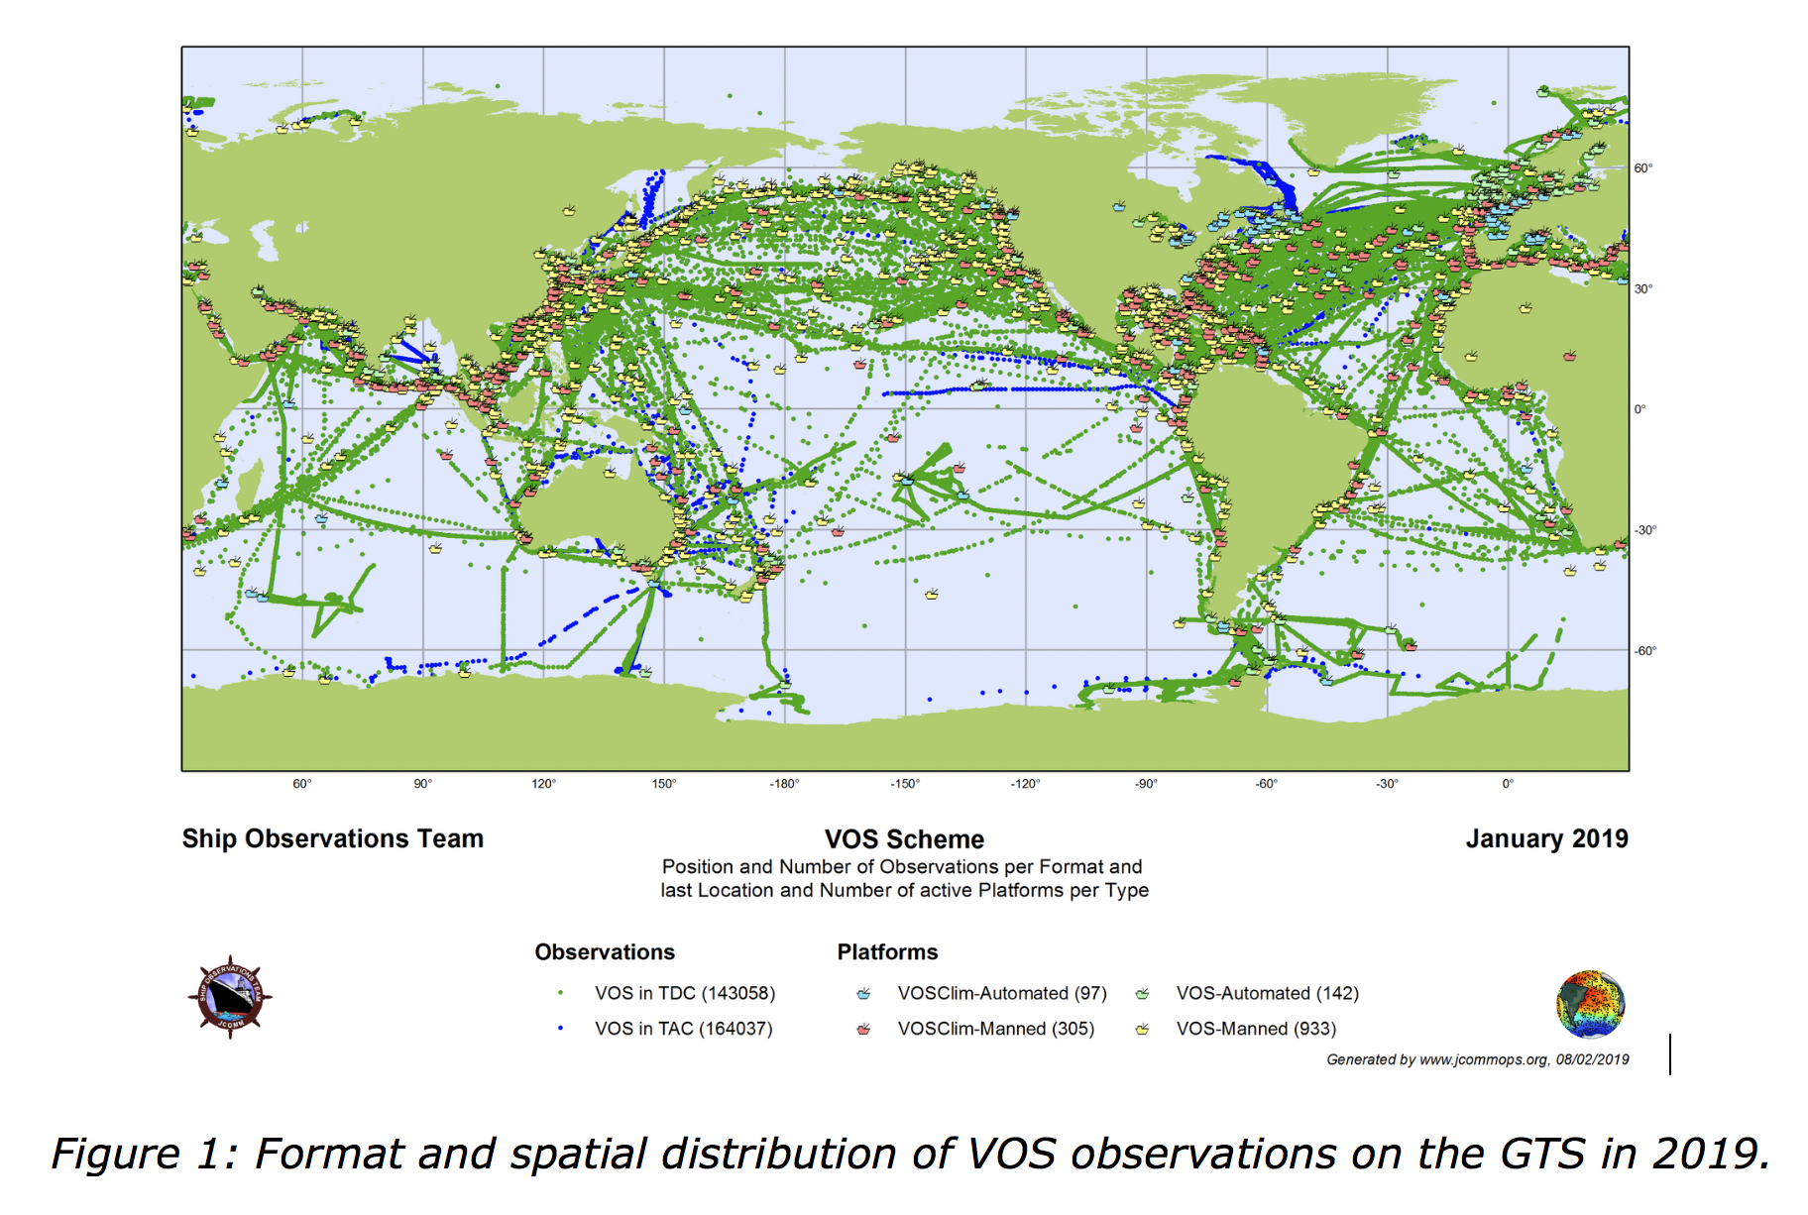
VOS BUFR coverage

Slide 14
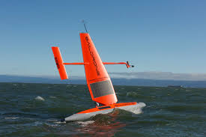
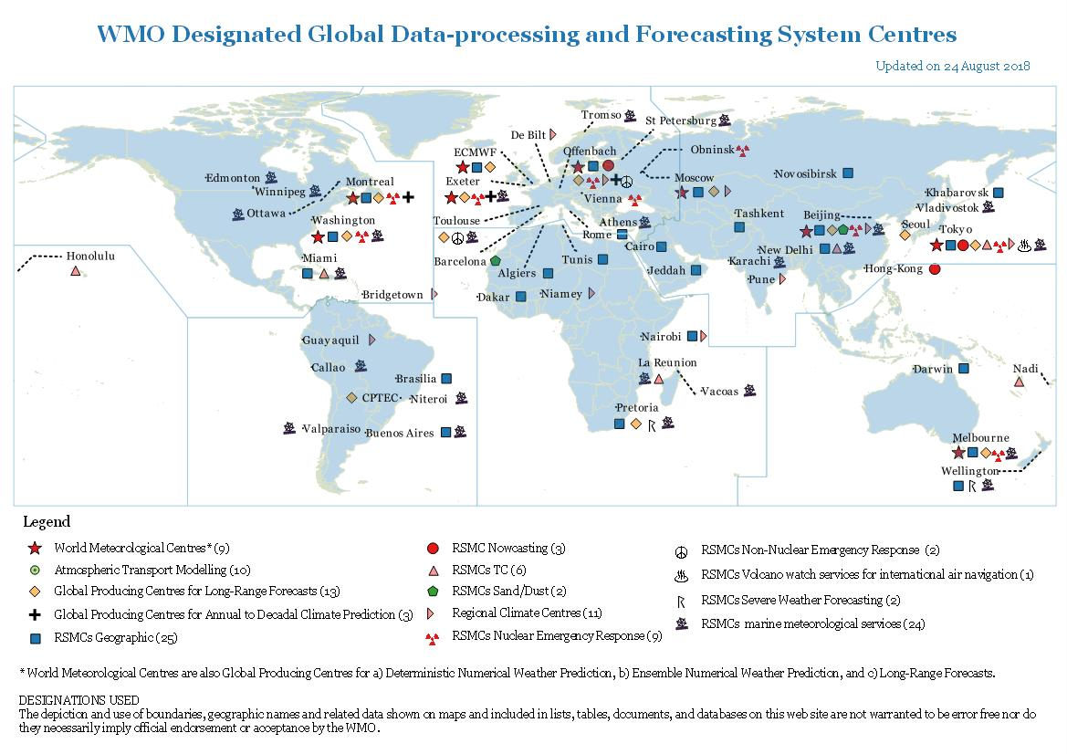
Saildrones
Open-GTS Collection and conversion to BUFR

Slide 15

Thank you
Merci

